Slide 1
The call stack

Slide 2
Outline
In this lesson, we will:
  Describe the call stack
  Step through an example
  Observe that we can assign to parameters
  Improve our fast_sin function
  Introduce the concept of recursion
  Look at how the call stack supports recursion

Slide 3
Where are local variables stored?
Recall that:
  Local variables are temporary storage
  When you call a function, you do not return the current function until the function that is called completes execution and returns
Suppose you were solving a problem:
  You could write details and data on a piece of paper
  If you had to solve a sub-problem, you could
    Get a new piece of paper, put it over the current one and work on the sub-problem until you have solved it
    You now return from solving the sub-problem by storing the solution and then returning the bottom piece of paper
  If you had a sub-sub-problem, you could go one step further by putting another piece of paper on top, and focusing on that problem until it is complete

Slide 4
Example
Like a stack of paper, local variables are stored on a virtual stack of memory
Suppose we have three functions:
int main();
int f( int m, int n );
int g( int m );

Slide 5
Example
int f( int m, int n ) {
// Three local variables...
int a{0};
int b{0};
double target{0.0};
// Do something...
return g( m - 1 )*n + 1;
}
int g( int m ) {
// Two local variables
double x{1.2};
unsigned int n{0};
// Do something...
return 2*m + 1;
}
    int main() {
    // Four local variables
    int a{7};
    int b{3};
    int c{};
    bool d{false};
    c = f( a, b );
    d = ( c == 0 );
    if ( d ) {
    b = g( a + c );
    } else {
    a = g( b + c );
    }
    std::cout << a << "," << b << "," << d << std::endl;
    }

Slide 6
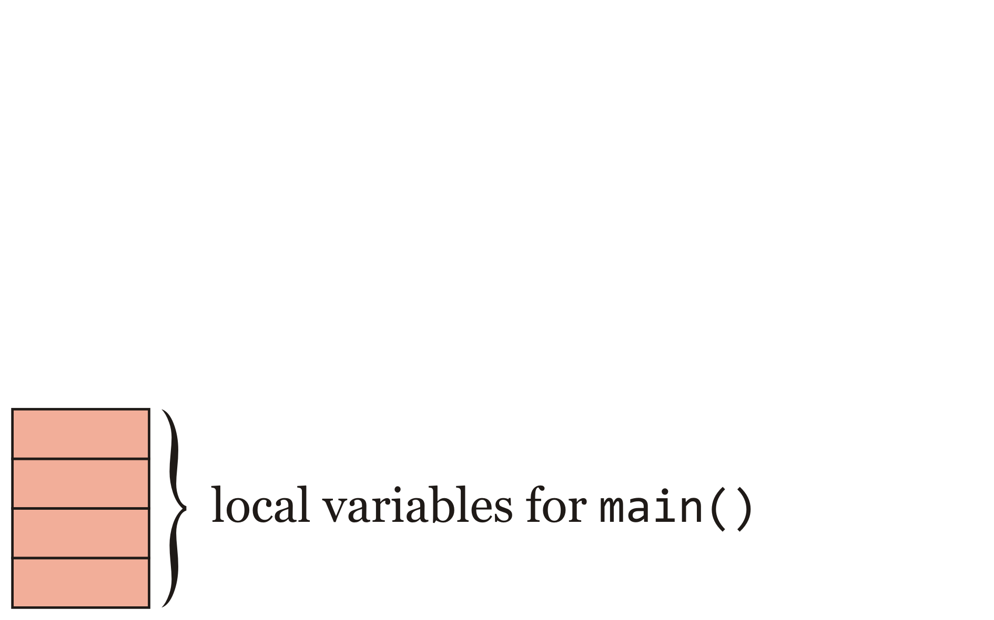
Example
We start in int main()
  The memory for all four local variables in main is on the stack

Slide 7
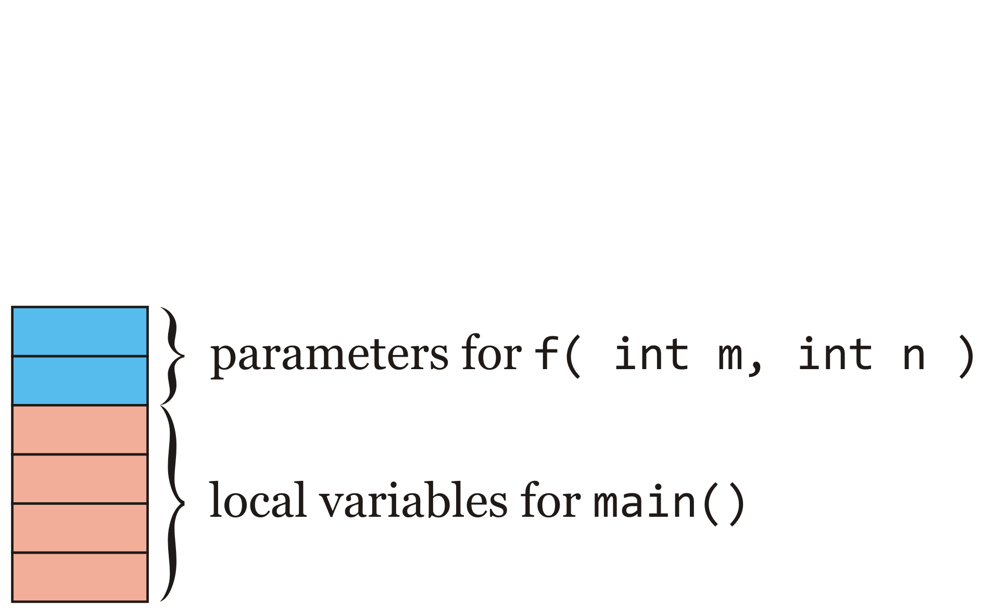
Example
The function int main() calls int f(…)
  The two arguments are put onto the stack
  These are now the parameters 'm' and 'n' for int f(…)

Slide 8
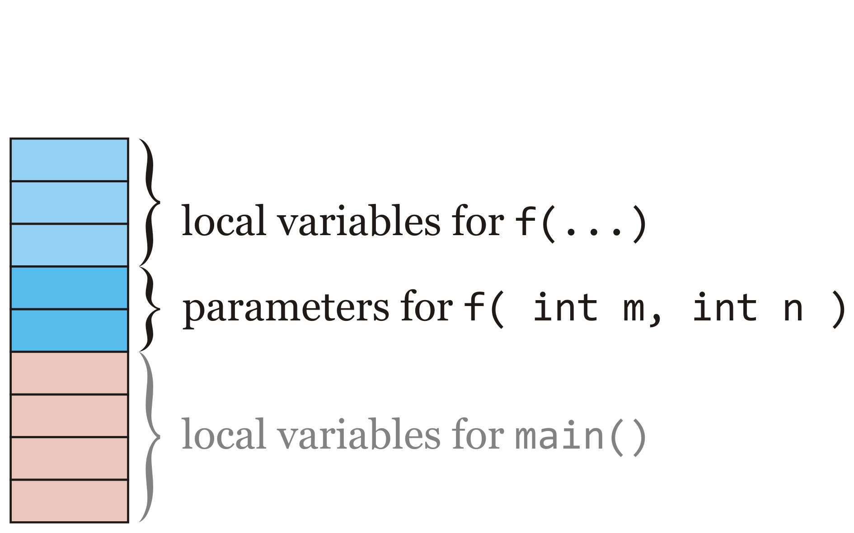
Example
The memory for the three local variables for int f(…) now appears on top of the parameters

Slide 9
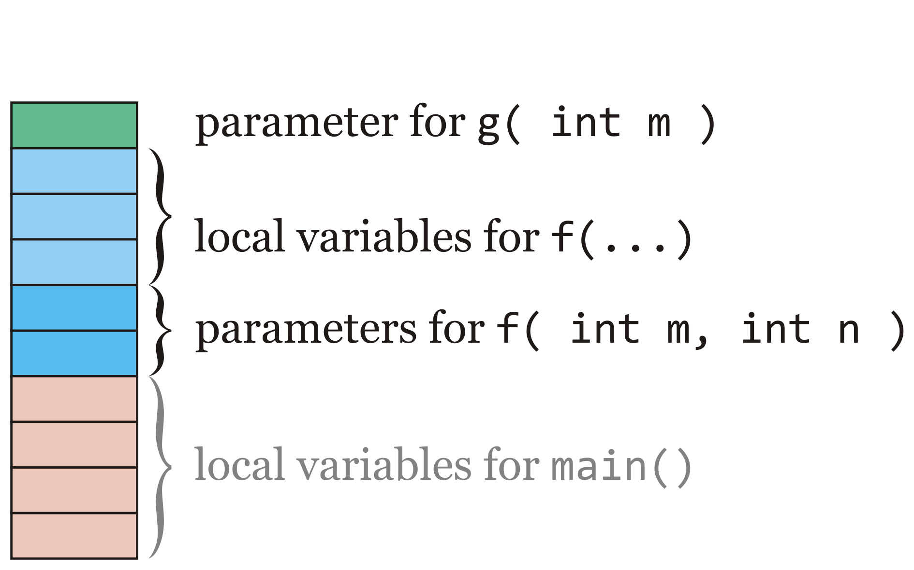
Example
The function int f(…) calls int g(…)
  The one argument is put onto the stack
  This is now the parameter 'm' for int g(…)

Slide 10
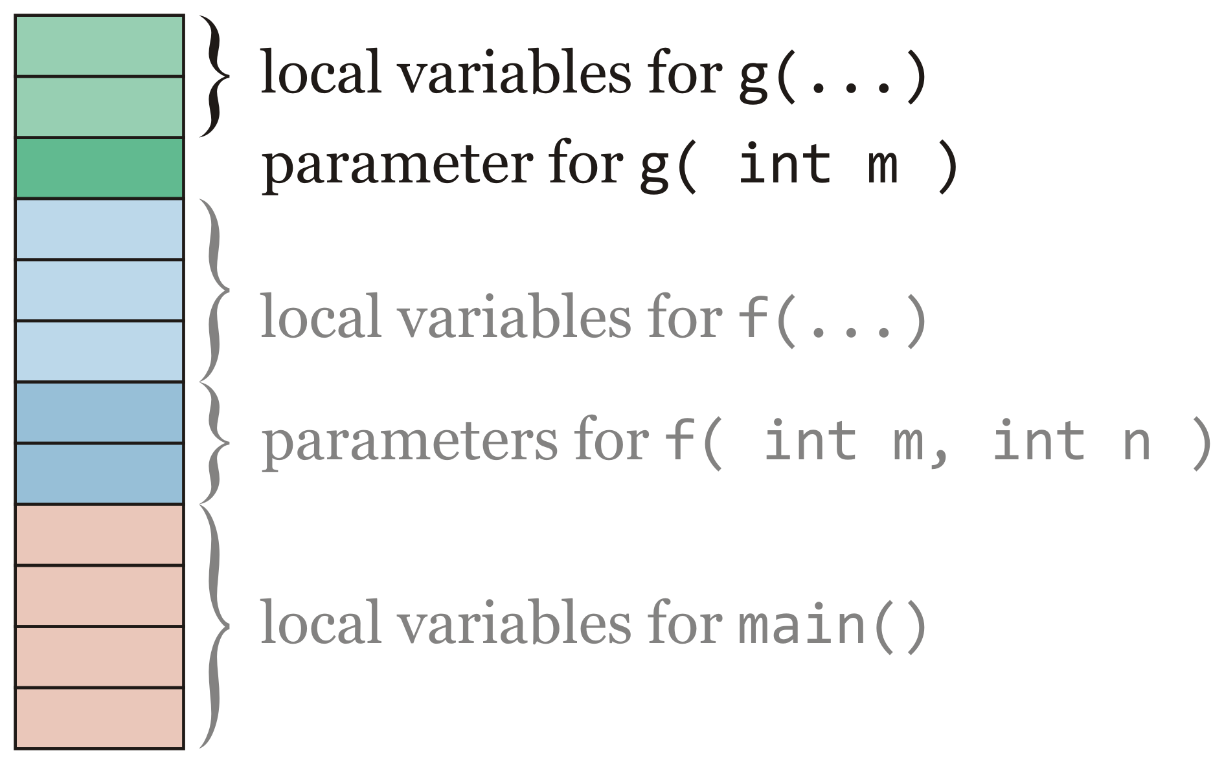
Example
The memory for the two local variables for int g(…) now appears on top of the parameters

Slide 11
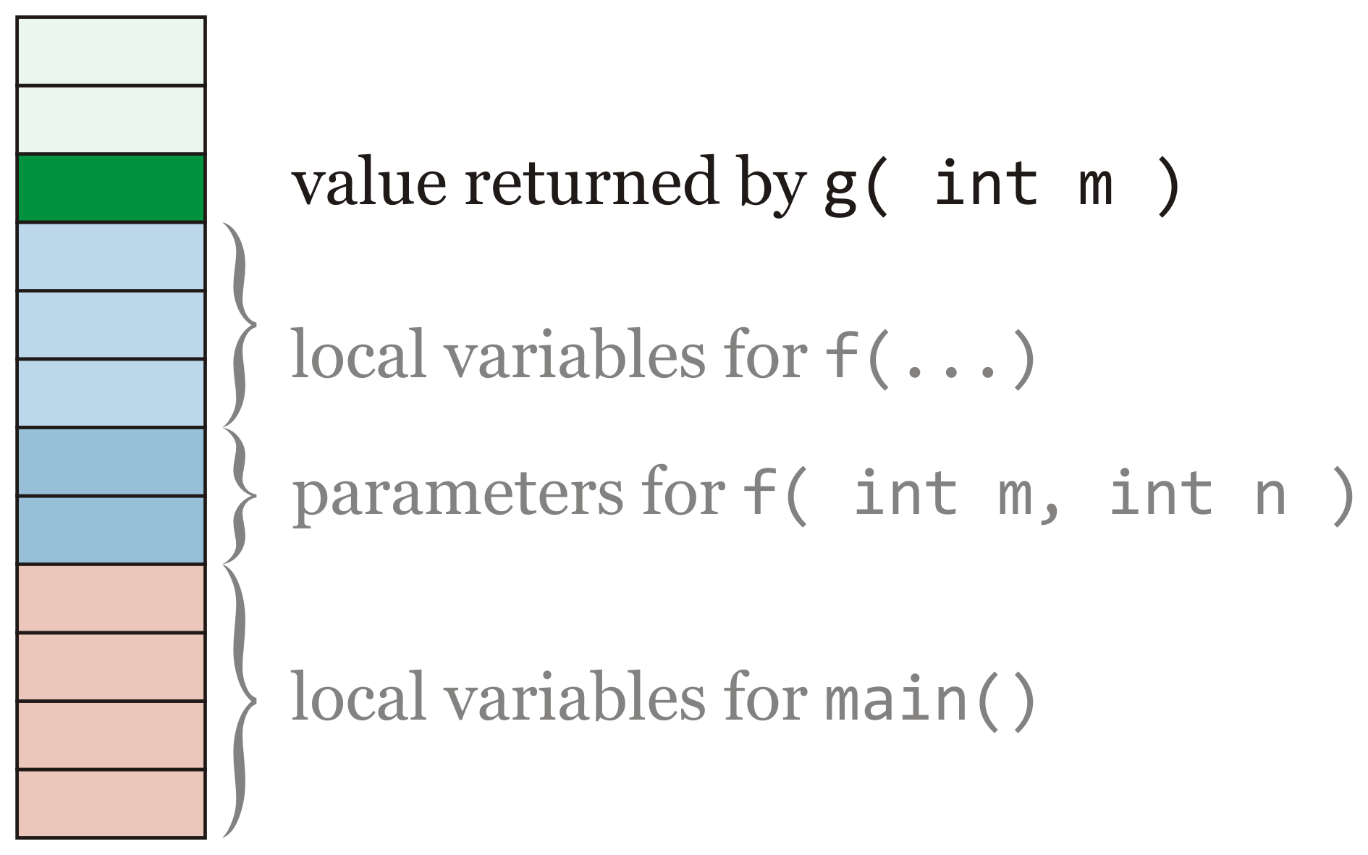
Example
When int g(…) is read to return, it puts its return value on the top of the stack
  The function int f(…) must immediately store or use that value

Slide 12
Example
The function int f(…) continues to execute
  The values of the parameters or local variables have not been changed by the call to int g(…)

Slide 13
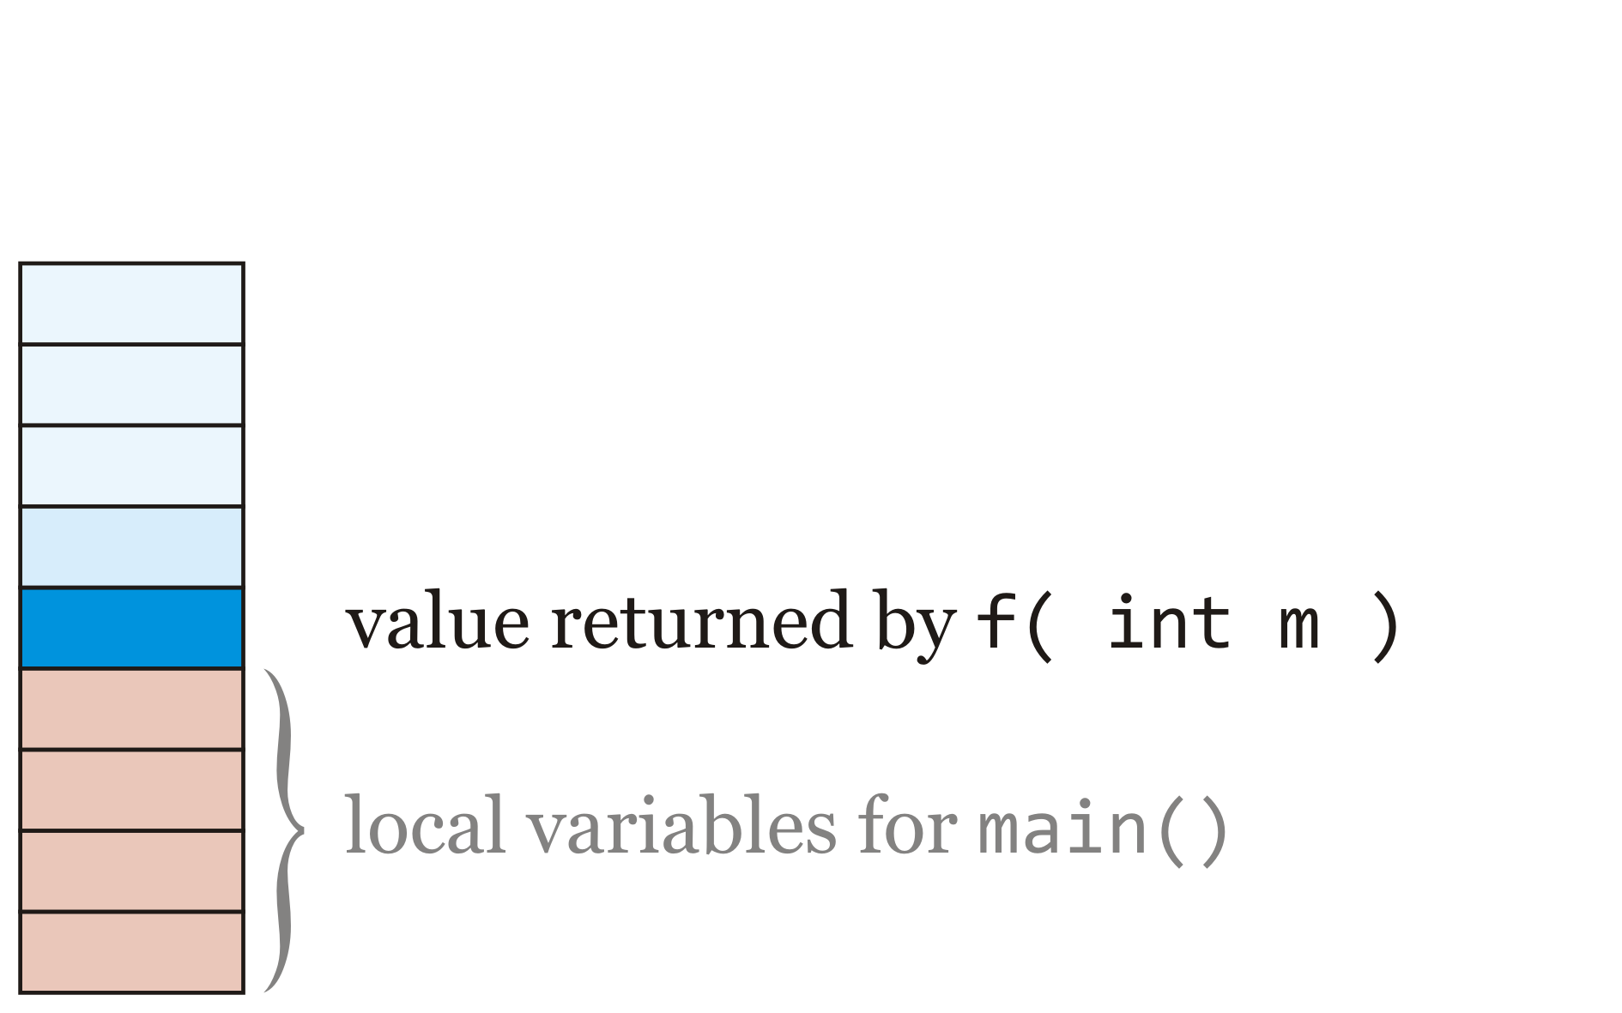
Example
When int f(…) is read to return, it puts its return value on the top of the stack
  The function int main() must immediately store or use that value

Slide 14
Example
The function int main() continues to execute
  The values of the local variables of int main() have not been changed by the call to int f(…) or the subsequent call to int g(…)

Slide 15
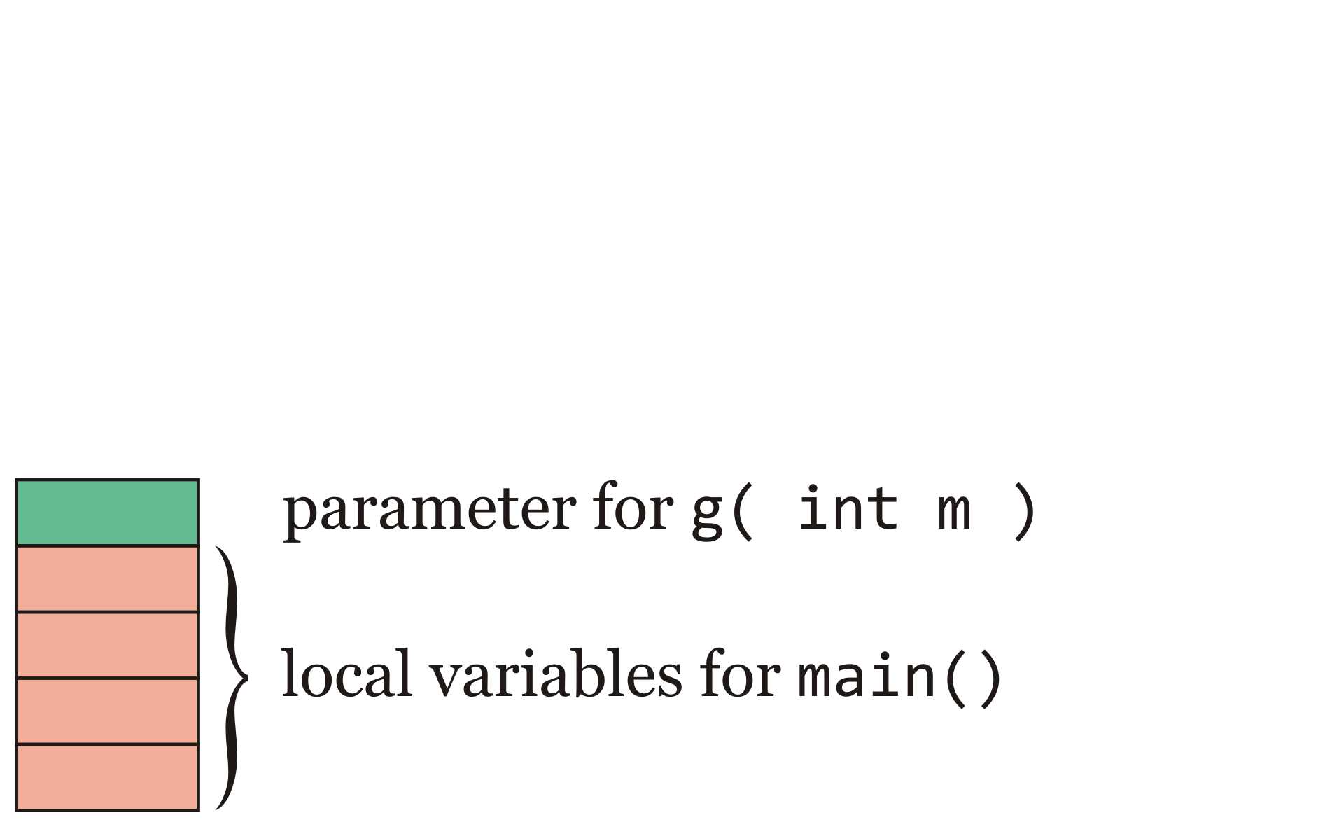
Example
The function int main() calls int g(…)
  The one argument is put onto the stack
  This is now the parameter 'm' for int g(…)

Slide 16
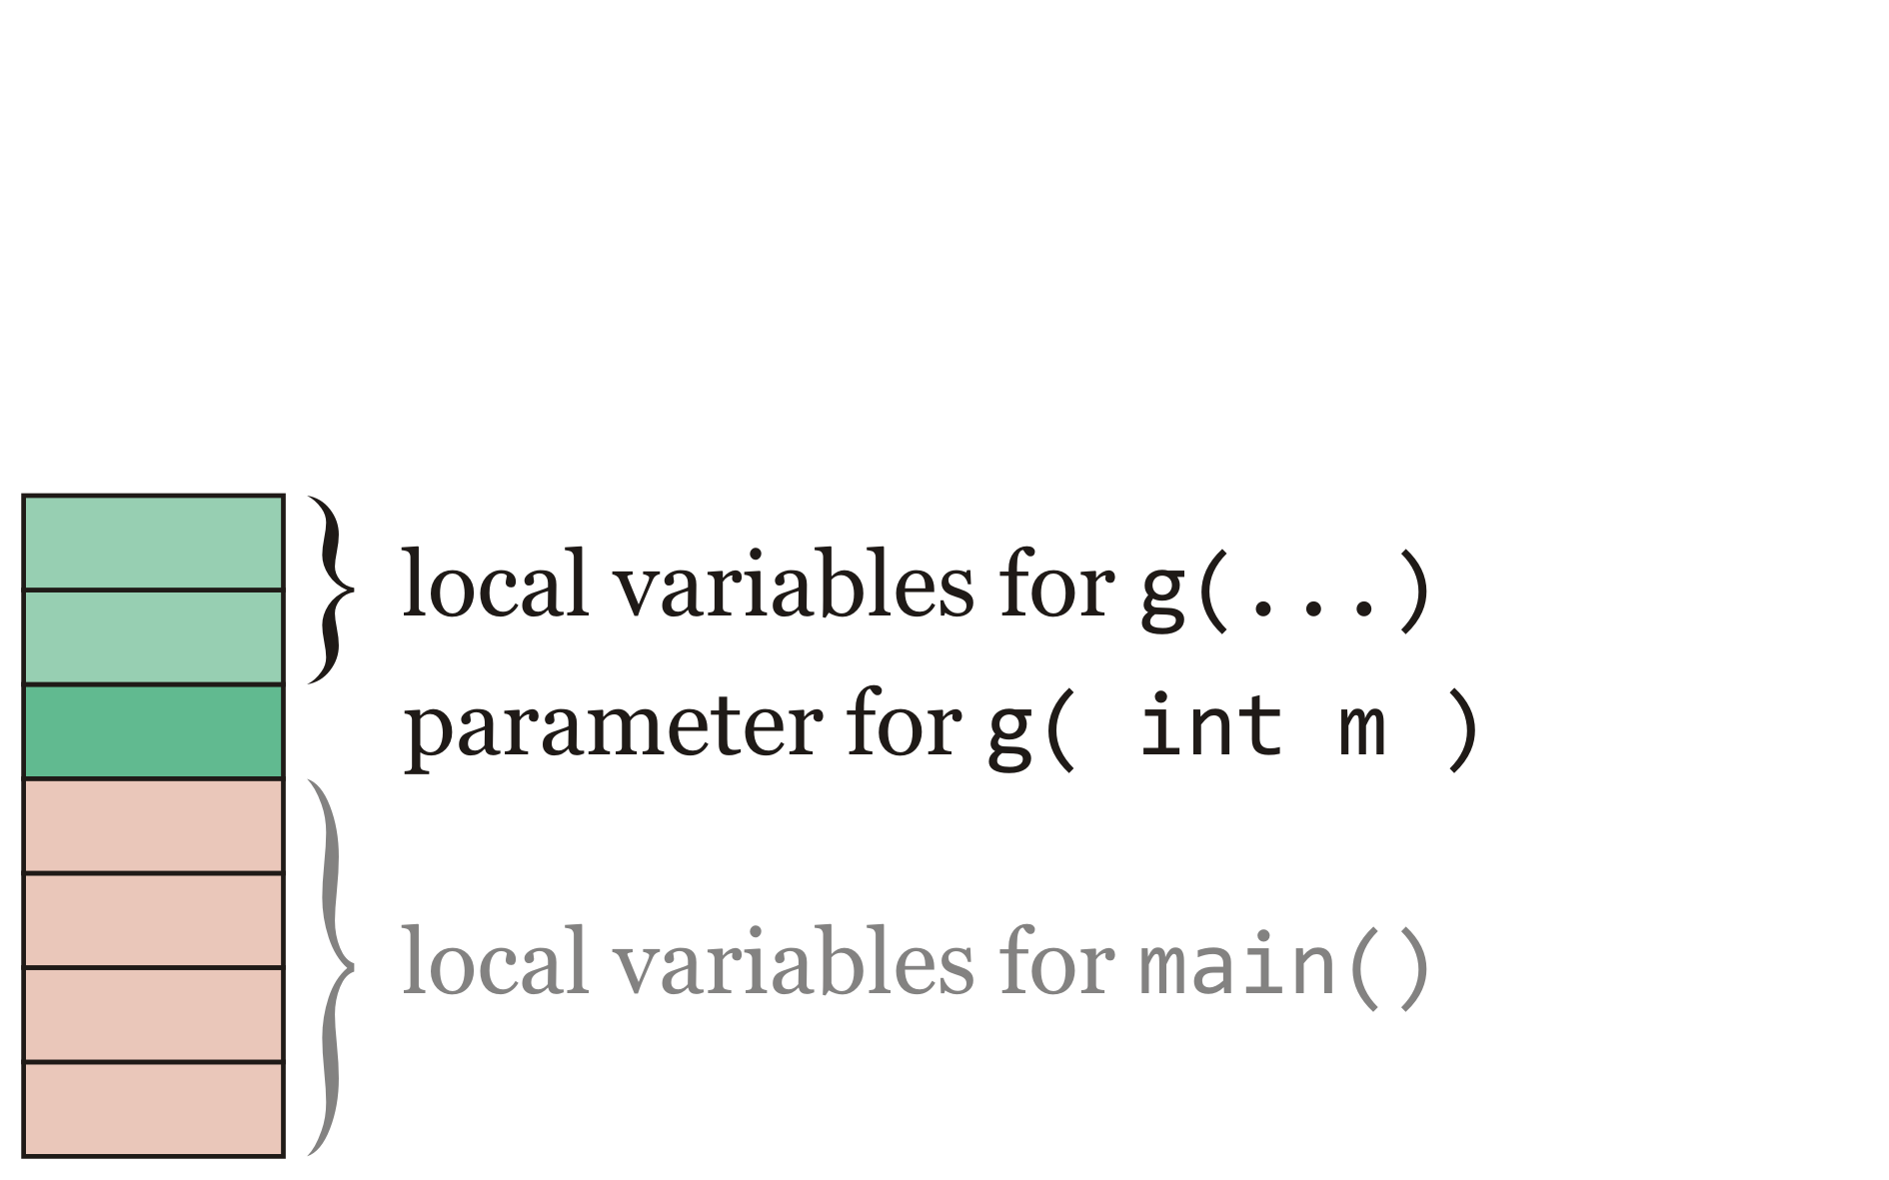
Example
The memory for the two local variables for int g(…) now appears on top of the parameters

Slide 17
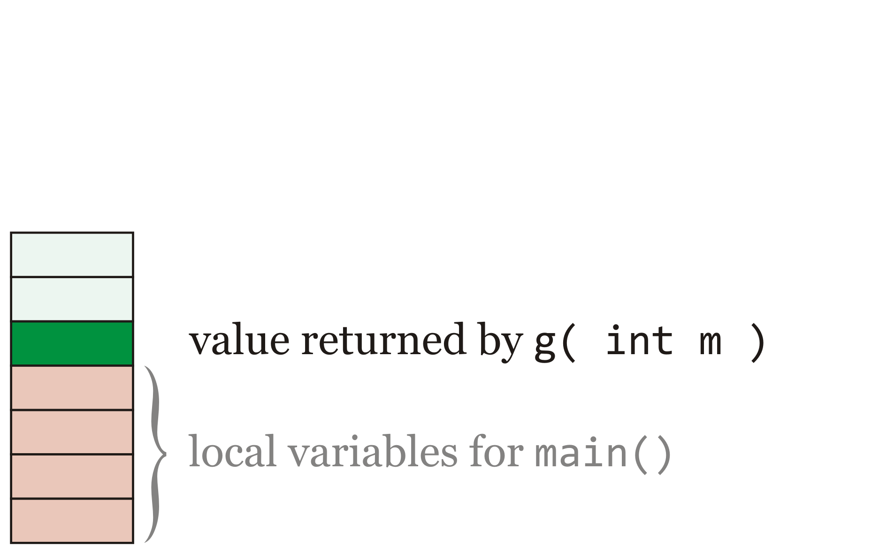
Example
When int g(…) is read to return, it puts its return value on the top of the stack
  The function int main() must immediately store or use that value

Slide 18
Example
The function int main() continues to execute
  The values of the local variables remain unchanged from before the function call

Slide 19
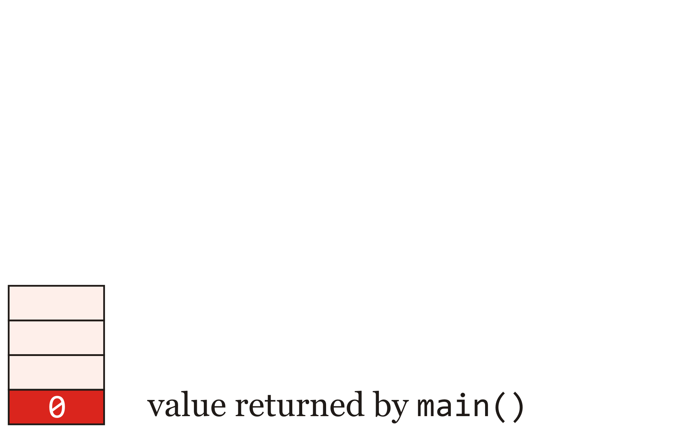
Example
The value returned by main, 0, is put on the top of the stack

Slide 20
The call stack
You will learn much more about the call stack in second-year courses
  Many behaviors will make more sense if you understand this concept
Note: the call stack is much more complex:
  How do we know where the parameters are, where to put the return value, and how functions know where to resume their execution after returning, etc.

Slide 21
Thought experiment revisited
Now you should be able to justify the output of this program
    #include <iostream>
    void f( int m );
    int main();
    void f( int m ) {
    int n; // Uninitialized!!!
    std::cout << n << std::endl;
    n = m;
    }
    int main() {
    std::cout << "Hello world!" << std::endl;
    f( 42 );
    f( 91 );
    f( 150 );
    return 0;
    }
The output is:
Hello world!
0
42
91

Slide 22
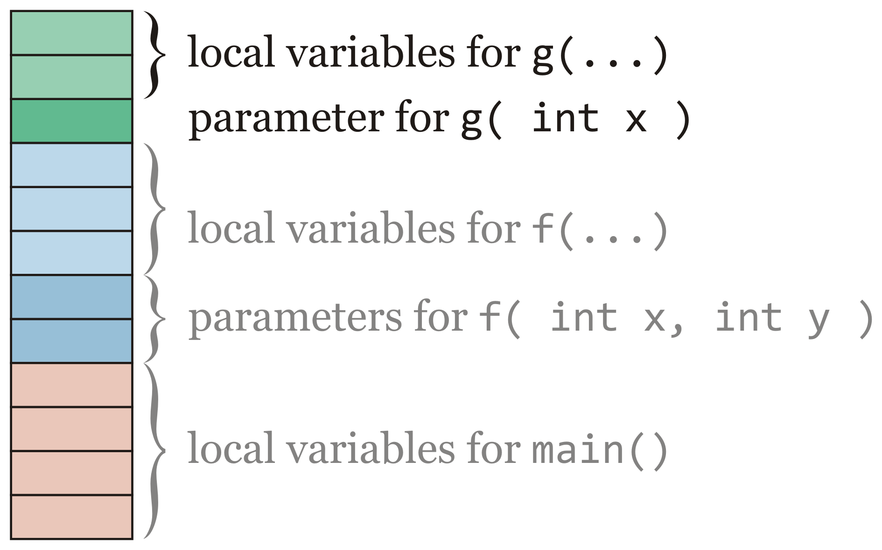
Assigning to parameters?
If local variables and parameters are on the stack, can we not also assign to parameters?
  Yes—we have not yet used this feature, but it is not uncommon

Slide 23
Assigning to parameters?
As an example of assigning to a parameter, consider the following function:
    double fast_cos( double x );
    double fast_cos( double x ) {
    if ( x < 0.0 ) {
    x = -x;
    }
    assert( (x >= 0.0) && (x <= 1.5707963267948966) );
    return (
    0.11073981636184074*x - 0.57923443134047191
    )*x*x + 1.0;
    }

Slide 24
Recursive function calls
We have discussed one function calling another
We will now consider the case where a function calls itself
  This is called a recursive function call
  The word is from Latin: recurrere meaning to “run back”
We will look at our fast sine function:
  double fast_sin( double x ) {
  double PI_BY_2{1.5707963267948966};
  assert( (x >= -PI_BY_2) && (x <= PI_BY_2) );
  if ( x < 0.0 ) {
  return –fast_sin( -x );
  }
  return ((-0.11073981636184074*x - 0.057385341027109429)*x + 1.0)*x;
  }

Slide 25
Recursion and the call stack
Let’s see how recursion uses the call stack:
    // Pre-processor include directives
    #include <cmath>
    // Function declarations
    int main();
    double fast_sin( double x );
    // Function definitions
    int main() {
    double var{fast_sin(-1.0)};
    std::cout << var << std::endl;
    return 0;
    }
    double fast_sin( double x ) {
    // Implementation of our fast sine function...
    }

Slide 26
Recursion and the call stack
Inside main(), we have the statement
    double var{fast_sin(-1.0)};
    To initialize 'var', we must call fast_sin with the argument -1.0
int main() {
double var{fast_sin(-1.0)};
std::cout << var << std::endl;
return 0;
}
? | var local variable for main()

Slide 27
Recursion and the call stack
    The literal -1.0 is placed on the call stack and fast_sin is called
int main() {
double var{fast_sin(-1.0)};
std::cout << var << std::endl;
return 0;
}
-1.0 | x parameter for fast_sin(-1.0)
? | var local variable for main()

Slide 28
Recursion and the call stack
    Inside fast_sin(…), memory is allocated for the local variable PI_BY_2 and that local variable is initialized
double fast_sin( double x ) {
double PI_BY_2{1.5707963267948966};
assert( (x >= -PI_BY_2) && (x <= PI_BY_2) );
if ( x < 0.0 ) {
return –fast_sin( -x );
}
return ((-0.11073981636184074*x
- 0.057385341027109429)*x + 1.0)*x;
}
1.570796… | PI_BY_2 local variable for fast_sin(-1.0)
-1.0 | x parameter for fast_sin(-1.0)
? | var local variable for main()

Slide 29
Recursion and the call stack
    The assertion passes and x < 0.0, so the consequent block is executed
      This is a call to fast_sin(…) with the argument -x
double fast_sin( double x ) {
double PI_BY_2{1.5707963267948966};
assert( (x >= -PI_BY_2) && (x <= PI_BY_2) );
if ( x < 0.0 ) {
return –fast_sin( -x );
}
return ((-0.11073981636184074*x
- 0.057385341027109429)*x + 1.0)*x;
}
1.0 | x parameter for fast_sin(1.0)
1.570796… | PI_BY_2 local variable for fast_sin(-1.0)
-1.0 | x parameter for fast_sin(-1.0)
? | var local variable for main()

Slide 30
Recursion and the call stack
    Now we call fast_sin(…) again but now with the argument 1.0
double fast_sin( double x ) {
double PI_BY_2{1.5707963267948966};
assert( (x >= -PI_BY_2) && (x <= PI_BY_2) );
if ( x < 0.0 ) {
return –fast_sin( -x );
}
return ((-0.11073981636184074*x
- 0.057385341027109429)*x + 1.0)*x;
}
1.0 | x parameter for fast_sin(1.0)
1.570796… | PI_BY_2 local variable for fast_sin(-1.0)
-1.0 | x parameter for fast_sin(-1.0)
? | var local variable for main()

Slide 31
Recursion and the call stack
    Inside fast_sin(1.0), memory is allocated for the local variable PI_BY_2 and that local variable is initialized
double fast_sin( double x ) {
double PI_BY_2{1.5707963267948966};
assert( (x >= -PI_BY_2) && (x <= PI_BY_2) );
if ( x < 0.0 ) {
return –fast_sin( -x );
}
return ((-0.11073981636184074*x
- 0.057385341027109429)*x + 1.0)*x;
}
1.570796… | PI_BY_2 local variable for fast_sin(1.0)
1.0 | x parameter for fast_sin(1.0)
1.570796… | PI_BY_2 local variable for fast_sin(-1.0)
-1.0 | x parameter for fast_sin(-1.0)
? | var local variable for main()

Slide 32
Recursion and the call stack
    The assertion passes, the condition fails, so we execute the last statement
      The expression evaluates to 0.83187484261104983
double fast_sin( double x ) {
double PI_BY_2{1.5707963267948966};
assert( (x >= -PI_BY_2) && (x <= PI_BY_2) );
if ( x < 0.0 ) {
return –fast_sin( -x );
}
return ((-0.11073981636184074*x
- 0.057385341027109429)*x + 1.0)*x;
}
1.570796… | PI_BY_2 local variable for fast_sin(1.0)
1.0 | x parameter for fast_sin(1.0)
1.570796… | PI_BY_2 local variable for fast_sin(-1.0)
-1.0 | x parameter for fast_sin(-1.0)
? | var local variable for main()

Slide 33
Recursion and the call stack
    The return value is placed onto the stack
double fast_sin( double x ) {
double PI_BY_2{1.5707963267948966};
assert( (x >= -PI_BY_2) && (x <= PI_BY_2) );
if ( x < 0.0 ) {
return –fast_sin( -x );
}
return ((-0.11073981636184074*x
- 0.057385341027109429)*x + 1.0)*x;
}
0.831874… | return value for fast_sin(1.0)
1.570796… | PI_BY_2 local variable for fast_sin(-1.0)
-1.0 | x parameter for fast_sin(-1.0)
? | var local variable for main()

Slide 34
Recursion and the call stack
    We are back to the call to fast_sin(-1.0):
      The returned value is negated, producing -0.83187484261104983
double fast_sin( double x ) {
double PI_BY_2{1.5707963267948966};
assert( (x >= -PI_BY_2) && (x <= PI_BY_2) );
if ( x < 0.0 ) {
return –fast_sin( -x );
}
return ((-0.11073981636184074*x
- 0.057385341027109429)*x + 1.0)*x;
}
0.831874… | return value for fast_sin(1.0)
1.570796… | PI_BY_2 local variable for fast_sin(-1.0)
-1.0 | x parameter for fast_sin(-1.0)
? | var local variable for main()

Slide 35
Recursion and the call stack
    We are back to the call to fast_sin(-1.0):
      The returned value is negated, producing -0.83187484261104983
      This value is placed onto the stack
double fast_sin( double x ) {
double PI_BY_2{1.5707963267948966};
assert( (x >= -PI_BY_2) && (x <= PI_BY_2) );
if ( x < 0.0 ) {
return –fast_sin( -x );
}
return ((-0.11073981636184074*x
- 0.057385341027109429)*x + 1.0)*x;
}
-0.83187… | return value for fast_sin(-1.0)
? | var local variable for main()

Slide 36
Recursion and the call stack
    Back in main(), the returned value is stored as the initial value for the local variable var
int main() {
double var{fast_sin(-1.0)};
std::cout << var << std::endl;
return 0;
}
-0.83187… | return value for fast_sin(-1.0)
-0.83187… | var local variable for main()

Slide 37
Recursion and the call stack
    The next line accesses and prints out that value
int main() {
double var{fast_sin(-1.0)};
std::cout << var << std::endl;
return 0;
}
-0.83187… | var local variable for main()

Slide 38
Recursion and the call stack
    Finally, main() returns, so the return value is placed onto the stack
int main() {
double var{fast_sin(-1.0)};
std::cout << var << std::endl;
return 0;
}
0 | return value for main()

Slide 39
Recursion and the call stack
Thus, the call stack allows recursion
  We will use recursion throughout this course
  It will appear in subsequent courses, as well
  Recursion allows us to solve a problem by reformulating the problem in simpler or alternate terms

Slide 40
Where to return?
Suppose we have this function:
    1 1 1 1 1 1 1 1 1 1 2 2 2 2 2 2 2 2 2 2 3 3 3 3 3 3 3 3 3 3 4 4 4 4 4 4 4 4 4 4 5 5 5 5 5 5 5 5 5 5
    1 2 3 4 5 6 7 8 9 0 1 2 3 4 5 6 7 8 9 0 1 2 3 4 5 6 7 8 9 0 1 2 3 4 5 6 7 8 9 0 1 2 3 4 5 6 7 8 9 0 1 2 3 4 5 6 7 8 9
    1 unsigned long fibonacci( unsigned long n ) {
    2 if ( n <= 1 ) {
    3 return 1;
    4 } else {
    5 return fibonacci( n - 1 ) + fibonnacci( n - 2 );
    6 }
    7 }
We call it with the argument 3
  First we call fibonacci( 2 ), so we must also put onto the stack 5:38
    When the function returns, it will execute the second call
  Next we call fibonacci( 1 ), so we must also put onto the stack 5:35
    When the function returns, it will execute the sum

Slide 41
Where to return?
Suppose we have this function:
    1 1 1 1 1 1 1 1 1 1 2 2 2 2 2 2 2 2 2 2 3 3 3 3 3 3 3 3 3 3 4 4 4 4 4 4 4 4 4 4 5 5 5 5 5 5 5 5 5 5
    1 2 3 4 5 6 7 8 9 0 1 2 3 4 5 6 7 8 9 0 1 2 3 4 5 6 7 8 9 0 1 2 3 4 5 6 7 8 9 0 1 2 3 4 5 6 7 8 9 0 1 2 3 4 5 6 7 8 9
    1 unsigned long fibonacci( unsigned long n ) {
    2 if ( n <= 1 ) {
    3 return 1;
    4 } else {
    5 return fibonacci( n - 1 ) + fibonnacci( n - 2 );
    6 }
    7 }
Note: this really isn’t what happens, but it is a reasonable good first approximation
– yes, information is put onto the stack
– more in your course on digital computers

Slide 42
Summary
Following this lesson, you now:
  Understand how the call stack supports function calls
    Parameters and local variables are grouped here
  Intuitively understand how the call stack is used
  Know that parameters as well as local variables can be assigned to
  Understand how mathematics can be used to solve problems
  Understand the concept of recursion
  Intuitively understand how the call stack is used to support recursion

Slide 43
References
[1] No references?

Slide 44
Acknowledgments
Proof read by Dr. Thomas McConkey and Charlie Liu.

Slide 45



Colophon
These slides were prepared using the Georgia typeface. Mathematical equations use Times New Roman, and source code is presented using Consolas.
The photographs of lilacs in bloom appearing on the title slide and accenting the top of each other slide were taken at the Royal Botanical Gardens on May 27, 2018 by Douglas Wilhelm Harder. Please see
https://www.rbg.ca/
for more information.

Slide 46
Disclaimer
These slides are provided for the ece 150 Fundamentals of Programming course taught at the University of Waterloo. The material in it reflects the authors’ best judgment in light of the information available to them at the time of preparation. Any reliance on these course slides by any party for any other purpose are the responsibility of such parties. The authors accept no responsibility for damages, if any, suffered by any party as a result of decisions made or actions based on these course slides for any other purpose than that for which it was intended.

